Slide 1
Introductory General Chemistry
Chemistry 3A
S. M. Halloran

Slide 2
Recommendations for Successful Performance in Chem 3A
Syllabus
The syllabus is your friend, your map to how the course is supposed to go
Understand it well: generally, answers questions of highest importance to students
Broad overview or outline of course content
Materials for course: freely accessible online “book”, lab gear (coat + goggles), scientific-grade calculator
Grading: components of performance in course
Examinations: midterms and final, quizzes
“Homework”:
Laboratory part of course: reports of experiments

Slide 3
Recommendations for Successful Performance in Chem 3A
Online Systems/Tools
Canvas
Announcements
Chat
Email
Mitch.Halloran@fresnocitycollege.edu

Slide 4
Recommendations for Successful Performance in Chem 3A
Interaction between instructor & student(s)
Part-time instructors interact through Canvas and email

Slide 5
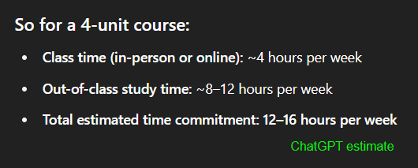
Recommendations for Successful Performance in Chem 3A
Attendance
Being at lecture & certainly being in the lab is not optional: attendance is recorded
Time Commitment
Reading, homework, study for exams/quizzes
Generally thought to be at least twice time/effort commitment of the hours (units) of lecture+lab: 4 units → 8-12 hours additional per week

Slide 6
Teamwork
Throughout your career, you will learn that projects and programs have teams of people in order to get work done successfully.
While tasks in projects are done by individuals performing roles as part of the team, the overall work is a product of the team
The “project” here at FCC in this course is learning chemistry, so everyone will be part of a team
This team is your study group

Slide 7
The Study Group
The Canvas LMS app was used to randomly group students into study groups in this course
The study group is only one facet of your learning process, intended to initiate you into being part of a team in your learning goal
Your instructor (me), your peers, resources of the College (tutors, tutoring services, counselors, other support staff) are always ready & present too

Slide 8
Communication Plan
All projects—like your success in this course—write out a communication plan
This is about what and how to communicate to move the project along
What to communicate
Asking about how to solve a problem, understanding details of an assignment, when is a deadline
Helping each other with reminders, setting up an interactive meeting online or in person
How to communicate
Email, phone text or a call
Canvas online system

Slide 9
Artificial Intelligence in Learning & Academics
The elephant in the room? Have you been talking about it in your course of learning?
Will be transformative, but…
useful to you IF you use it properly
ChatGPT/Bing CoPilot/Gemini don’t initiate the “what if” and “why” that drives discovery and exploration
A.I. does not and will not replace humans in asking questions that push discovery
Learning the foundations of a discipline—that is, getting that Associates or Bachelors or Doctoral degree—makes you that better thinker who is asking “what if” and “why”
Doing that “homework”…
Helps you pass the test, yes
But also builds you as a discoverer, explorer, researcher, thinker

Slide 10
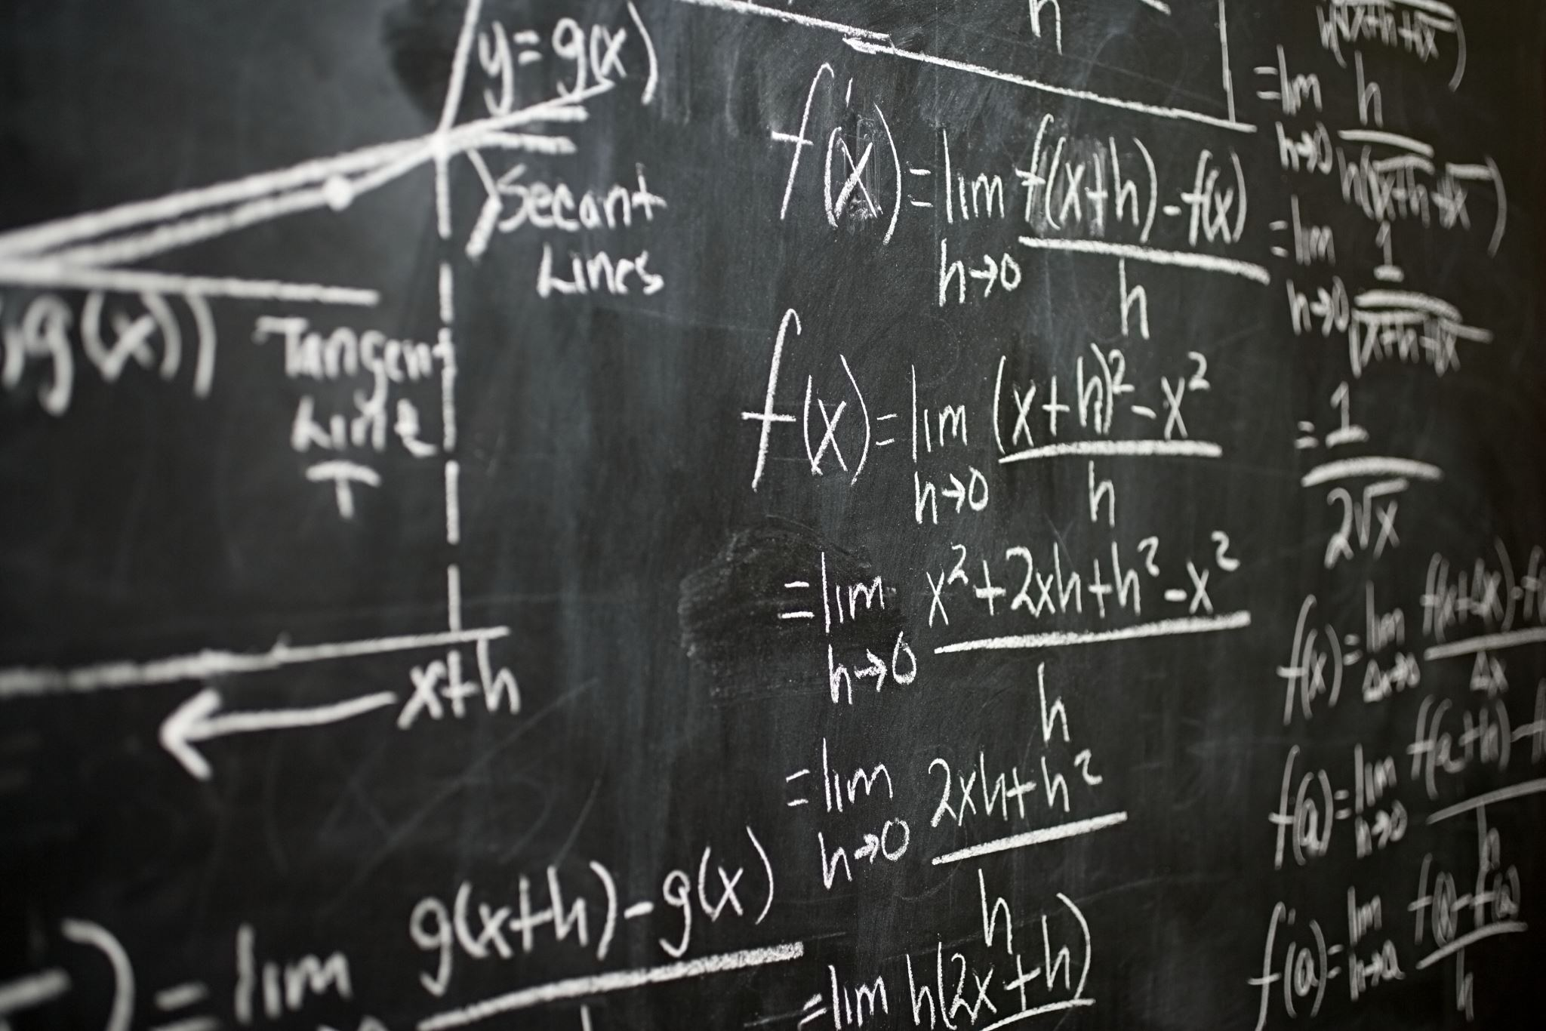
Numbers, Calculations, Measurements in Chemistry

Slide 11
Quantities
Number | Dimension
1 | mile
3 | teaspoons

Slide 12
Scientific Notation
A way of expressing numerical values
Format: d.mmm × 10^{n}
Part | n.mmm
Part Name | Significand (preferred), Coefficient, (Mantissa is obsolete term)
Part Property | Number greater than or equal to 1.0 and less than 10. This number properly express significant digits
Part | 10^{n}
Part Name | Exponent
Part Property | Exponent of 10 where n is integer, negative, positive (note 10⁰ = 1)

Slide 13
Scientific Notation
decimal point moves to right
1. = 10⁰
10. = 10¹
100. = 10²
decimal point moves to left
0.1 = 10⁻¹
0.01 = 10⁻²
0.001 = 10⁻³
1 atmosphere (atm) = 101,325 Pascals (Pa)

Slide 14
Scientific Notation
Is the number less than 10 and greater than 1?
You don’t really need scientific notation, because it will be [ d.mmm × 10⁰ ] and 10⁰ = 1, so → d.mmm
Otherwise take the number and express as d.mmm
If original number is greater than d.mmm you have to multiply by 10¹ n times to get to original number, so n will be positive (greater than zero): n × 1 = n (greater than zero)
If original number less than d.mmm you have to multiply by 10⁻¹ n times to get to original number, so n will be positive (greater than zero): n × -1 = -n (less than zero)

Slide 15
Scientific Notation
If original number is greater than d.mmm you have to multiply by 10¹ n times to get to original number, so n will be positive (greater than zero): n × 1 = +n
Your book: “if you moved decimal point to the left n places, then n is positive”
35 → 35. → 3.5 moved to left 1 place
3.5 × 10¹
23849 → 23849. → 2.3849 moved to left 4 places
2.3849 × 10⁴

Slide 16
Scientific Notation
If original number less than d.mmm you have to multiply by 10⁻¹ (or divide by 10) n times to get to original number, so n will be negative (less than zero): n × -1 = -n
Your book: “if you moved decimal point to the right n places, then n is negative”
0.0000035 → 3.5 moved to right 6 places
3.5 × 10⁻⁶
0.023849 → 2.3849 moved to right 2 places
2.3849 × 10⁻²

Slide 17
Scientific Notation
Patterns for memorizing
decimal point movement – number being changed – final exponent value
Left – Large – Positive
Right – Small – Negative
Positive and negative for exponent, not significand!
34249 → 3.4249 × 10⁴
-34249 → -3.4249 × 10⁴
0.0034249 → 3.4249 × 10⁻³
-0.0034249 → -3.4249 × 10⁻³

Slide 18
Scientific Notation
Scientific notation is actually a product of two numbers: the significand and a power of 10!
34249 = 3.4249 × 10⁴ = 3.4249 × 10,000 = 34249
-34249 = -3.4249 × 10⁴ = -3.4249 × 10,000 = -34249
0.0034249 = 3.4249 × 10⁻³ = 3.4249 × 0.001 = 0.0034249
-0.0034249 = -3.4249 × 10⁻³ = -3.4249 × 0.001 = -0.0034249
Use this feature to confirm whether you converted a number to scientific notation properly!

Slide 19
Significant Digits
Significant digits indicate the precision, the confidence of a single measurement
Also called significant figures
Measurement/Value | Significant Digits | Explanation
1.7 | 2 | All non-zero digits significant
1.732 | 4
17.32704 | 7 | Zeroes between non-zero digits are significant

Slide 20
Significant Digits
Measurement/Value | Significant Digits | Explanation
0.0045 | 2 | leading zeroes after decimal point not significant
0.00450 | 3 | trailing zeroes after decimal are significant
1200 | 2
1200. | 4 | assertion of decimal point makes significant
0.000 | 0 | no non-zero digits at all
1000.0 | 5 | adding decimal point and any zeroes after it makes all digits significant
100 | 1 | evaluated like the “1200” example above
1.200 × 10⁻³ | 4 | all digits in scientific notation should be significant

Slide 21
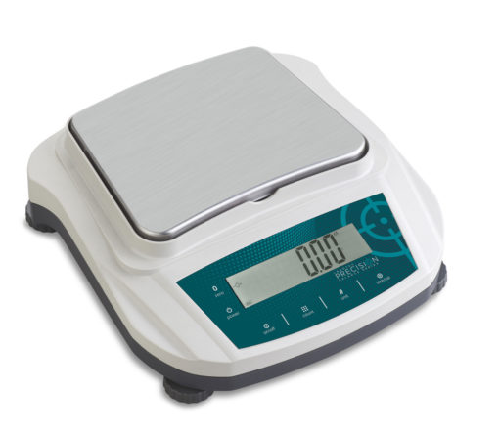
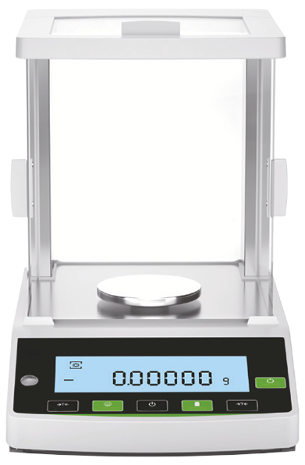
Significant Digits
Significant digits indicate the precision, the confidence of a single measurement
Preparative balance
Measuring quantities usually 0.1 g (100 mg) or greater
used to weigh masses for starting a chemistry experiment
Precision example: 3.4 g sodium chloride (NaCl)
Analytical balance
Measuring quantities usually down to 0.0001 g (0.1 mg or 100 µg) or greater
used to weigh masses for determining yield of product at end of a chemistry experiment
Precision example: 0.0241 g copper(II) sulfate pentahydrate

Slide 22
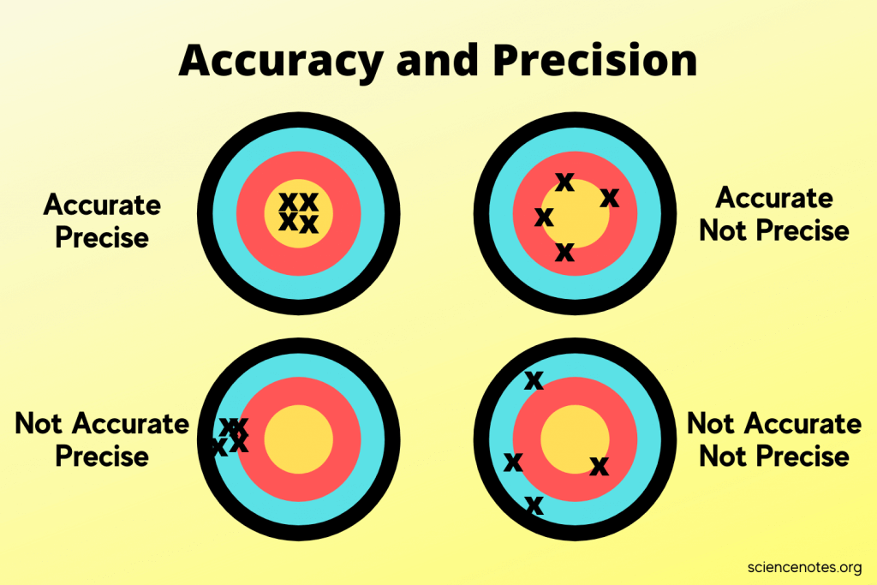
Significant Digits
Multiple Measurements
Precision – an indicator of how measurements repeat the value being measured
Accuracy – an indicator of how measurements get to the true value

Slide 23
Significant Digits in Scientific Notation
The rules on significant digits in numerical values always apply in scientific notation
2.69 × 10⁻⁵ = 0.0000269 (3 significant digits)
2.69000 × 10⁻⁵ = 0.0000269000 (6 significant digits)
2.69 × 10³ = 2690 (3 significant digits)
You still have add the zero to get standard form of number as integer
2.69000 × 10³ = 2690.00 (6 significant digits)

Slide 24
Significant Digits in Scientific Notation
The rules on significant digits in numerical values always apply in scientific notation
2.69 × 10⁻⁵ = 0.0000269 (3 significant digits)
2.69000 × 10⁻⁵ = 0.0000269000 (6 significant digits)
2.69 × 10³ = 2690 (3 significant digits)
You still have add the zero to get standard form of number as integer
2.69000 × 10³ = 2690.00 (6 significant digits)

Slide 25
“Conversion Factors”
Calculations in chemistry frequently require converting between the dimensions of a quantity
Volume: fluid ounces to milliliter (“fl oz” to “ml”)
Temperature: Celsius to Kelvin (“°C” to “K”)
Pressure: torr to atmosphere (“torr” to “atm”
Conversions not just about measurement systems but also include scales which are powers of 10
1 liter (L) = 1000 milliliters (ml, sometimes mL)
1 kilogram (kg) = 1000 grams (g)

Slide 26
Conversion Nomenclature
Prefix | Meaning | Example
Multiple of 10 (greater than 1)
kilo- (k) | 10³ = 1000 | 2 kilograms (kg) = 2000 grams
mega- (M) | 10⁶ = 1,000,000 | 3.7 megajoules (MJ) = 3,700,000 J
giga- (G) | 10⁹ = 1,000,000,000 | 10 gigahertz (GHz) = 10,000,000,000 Hz
Submultiples of 10 (fractions of 1)
deci- (d) | 10⁻¹ = 1/10 | 1 deciliter (dL, dl) = 0.1 L
centi- (c) | 10⁻² = 1/100 | 2.54 centimeter (cm) = 0.0254 m
milli- (m) | 10⁻³ = 1/1000 | 14 millibar (mbar) = 0.014 bar
micro- (u/µ) | 10⁻⁶ = 1/1000000 | 259 microliters (µl, ul, µL, uL) = 0.000259 L
nano- (n) | 10⁻⁹ = 1/1000000000 | 34 nanograms (ng) = 0.000000034 g
pico- (p) | 10⁻¹² = 1/100000000000 | 250 picoliters (pL) = 0.00000000025 L
femto- (f) | 10⁻¹⁵ =1/ 1000000000000000 | 4.3 femtomoles (fmol) = 0.0000000000000043 mol
Dimensions in green are often used in chemistry

Slide 27

Density
How much mass is in a given volume
The math definition:
Greek letter rho (ρ) is symbol for density
$$density= \frac{mass}{volume}$$
$$ρ=\frac{m}{V}$$

Slide 28
Temperature
A measure of the average kinetic energy of particles in a substance
Not energy itself, but an indicator or measure of energy

Slide 29
Measuring Temperature

Slide 30
Temperature Scales
Three scales (measurement types) are used to get a value of temperature
Thermometers usually involve expansion or contraction of calibrated sealed tube of mercury (Hg) or dyed-alcohol
Scale | Water Property
 | freezing point | boiling point
Fahrenheit | 32° F | 212° F
Celsius (centigrade) | 0° C | 100° C
Kelvin | 273 K | 373 K

Slide 31




Converting Temperature
Conversions apply basic algebraic principles of sloped lines
s$\text{lope} =\frac{373 −273}{100 − 0}$ = 1
$$°C =K −273$$
2$73 =1 ×0+\text{intercept}$
Intercept = 273
K$=°C+273$

Slide 32


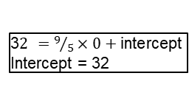

Converting Temperature
Fahrenheit not used in chemistry, but be prepared to convert.
s$\text{lope} =\frac{212 −32}{100 − 0}=\frac{180}{100}=\frac{9}{5}$
$$°C =\frac{5}{9}\left(°F −32\right)$$
3$2 =9/5×0+\text{intercept}$
Intercept = 32
°$F =\frac{9}{5}°C+32$

